Slide 1



FreshMart Sales Performance Dashboard
Interactive Business Intelligence & Executive Analytics
Converting raw transactional data into high-impact KPIs, dynamic pivot analytics, and automated decision-making tools.

Slide 2
PROBLEM STATEMENT & OBJECTIVE
Bridging Operational Data Gaps
Core Operational Challenges:
DASHBOARD SOLUTION
No tracking of net profits versus store expenses.
Automated Decision Engine
Build an interactive Excel dashboard with dynamic slicers to evaluate store health, transaction volumes, and product margins in seconds.
Slow counting of total sales and units by hand.
Unclear view of which categories make profit.
100%
4 Slicers
Slow comparison between store, web, and app sales.
Automated Reporting
Instant Cross-Filtering

Slide 3
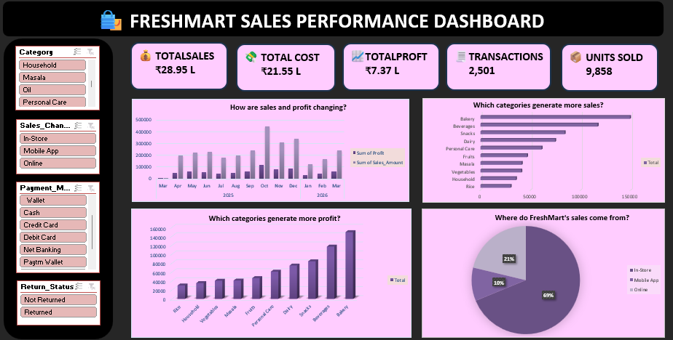


INTERACTIVE SOLUTION
FreshMart Executive Dashboard
₹28.95 L
₹21.55 L
₹7.37 L
2,501
9,858
Total Sales
Total Cost
Total Profit
Transactions
Units Sold
4 Core Visual Charts
Monthly Sales & Profit • Sales by Category • Profit by Category • Sales Channel Split
4 Dynamic Slicers
Category • Sales Channel • Payment Mode • Return Status

Slide 4
TECHNICAL ARCHITECTURE
Data Analysis Structure
1. Monthly Sales & Profit
2. Sales by Category
Rows: Transaction Date (Month/Year)
Rows: Product Category
Values: Sales Amount, Net Profit
Values: Sum of Sales Amount
Tracks revenue trajectory and seasonal spikes.
Identifies top revenue-generating product lines.
3. Profit by Category
4. Sales by Channel
Rows: Product Category
Rows: Sales Channel
Values: Sum of Net Profit
Values: Sum of Sales Amount
Highlights bottom-line margin drivers.
Evaluates In-Store, Mobile App, and Web volume.

Slide 5
BUSINESS VALUE
Strategic Insights & Impact
Data Insights
Management Benefits
Revenue & Margin: ₹28.95 L Sales with ~25.4% healthy profit margin (₹7.37 L).
Instant Monitoring: Real-time tracking of headline business KPIs.
High Volume: Processed 2,501 orders across 9,858 units sold.
Interactive Slicing: Segment data by Channel, Category, and Return Status.
Seasonality: Monthly trend tracking isolates peak purchasing periods.
Data-Driven Strategy: Supports targeted inventory and promotion planning.

Slide 6
Actionable Recommendations
Promote High-Profit Products: Feature Bakery items and Beverages at store entrances to maximize profit margins.
Grow Mobile Sales: Offer exclusive discounts to expand the Mobile App channel from its current 10% share.
Prepare for Peak Season: Increase inventory and staffing before October to handle the year-end sales spike.
Bundle Product Categories: Pair low-margin staples like Rice with high-margin items like Spices to increase order values.
Minimize Returns: Track returned orders on the dashboard to identify and fix product quality issues.

